Slide 1
Respiratory physiology

Slide 2
Unit 1

Slide 3
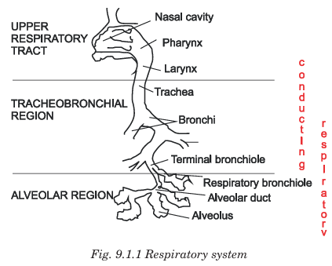

Slide 4
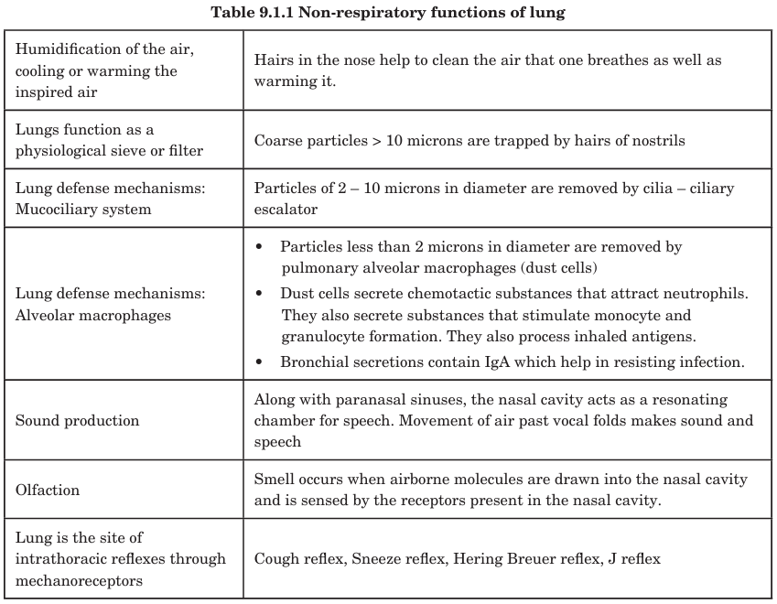

Slide 5
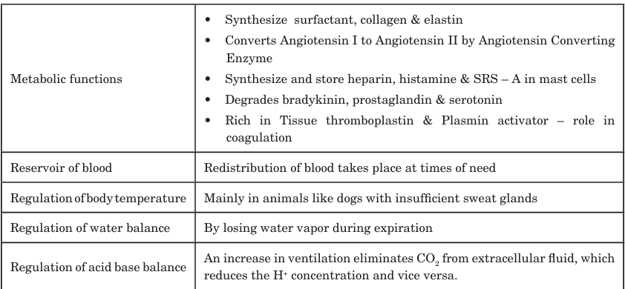

Slide 6
Function | Explanation
Gas exchange | O₂ uptake & CO₂ elimination
Acid–base regulation | Controls CO₂ to regulate pH
Maintains PO₂/PCO₂ | Maintains required gas levels
Temperature & water balance | Humidifies and warms inspired air
Filtration | Removes microemboli
Metabolic functions | ACE activation, surfactant production
Blood reservoir | Stores blood
Phonation | Helps speech generation
Immune defense | Mucociliary action and macrophages

Slide 7
Unit 2

Slide 8
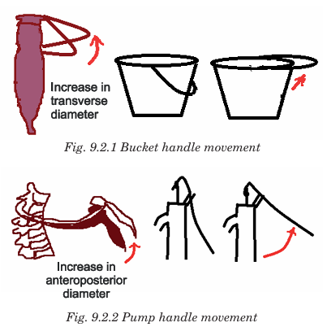

Slide 9
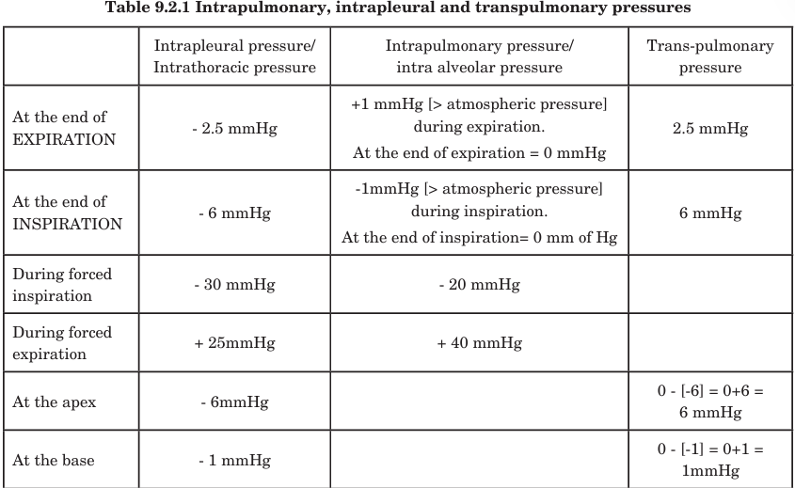

Slide 10
Unit 3

Slide 11

COMPLIANCE
Lung compliance is the ease with which the lungs expand during inspiration.
It represents the change in lung volume per unit change in transpulmonary pressure.
$\text{Compliance}=\frac{Δ\text{Volume}}{Δ\text{Pressure}}$
🔹 Normal Value
0.2 L / cm H₂O (or 200 mL/cm H₂O) for lungs & thoracic wall together

Slide 12
SURFACTANT
Pulmonary surfactant is a phospholipid-protein substance secreted by Type II pneumocytes that reduces surface tension in alveoli.
🔹 Major Component
Dipalmitoyl phosphatidylcholine (DPPC)
Clinical Points
Surfactant appears from 24 weeks gestation, adequate by 34–36 weeks
Deficiency → Neonatal Respiratory Distress Syndrome (RDS) in premature babies
Function | Result
Reduces surface tension | ↑ Lung compliance
Prevents alveolar collapse (atelectasis) | Stabilizes alveoli
Keeps alveoli dry | Opposes fluid entry
Reduces work of breathing | Easier ventilation
Prevents collapse of small alveoli | Equalizes pressures (Laplace’s law)

Slide 13

Ventilation–Perfusion Ratio (V/Q Ratio)
🔹 Definition
The V/Q ratio expresses the relationship between alveolar ventilation (V) and pulmonary blood flow/perfusion (Q).
$\text{V}\text{/}\text{Q} \text{Ratio}=\frac{\text{Alveolar} \text{Ventilation}}{\text{Pulmonary} \text{Blood} \text{Flow}}$
🔹 Normal Values
Normal V/Q = 0.8
  Ventilation ≈ 4 L/min
  Perfusion ≈ 5 L/min

Slide 14
Topic | Key Point | Clinical Importance
Compliance | Ease of lung expansion | ↓ in fibrosis & edema, ↑ in emphysema
Surfactant | ↓ surface tension, ↑ compliance | Deficiency causes Neonatal RDS
V/Q Ratio | Ventilation vs. perfusion relationship | Imbalance leads to hypoxemia

Slide 15
Unit 4

Slide 16
PARTIAL PRESSURE DIFFERENCE
Location | PO₂ (mmHg) | PCO₂ (mmHg)
Alveoli | 104 | 40
Venous blood entering lungs | 40 | 46
Arterial blood leaving lungs | 95–100 | 40

Slide 17
Gas exchange sequence:
O₂ diffuses from alveoli → blood
CO₂ diffuses from blood → alveoli
CO₂ diffuses 20 times faster than O₂ because of higher solubility.

Slide 18
FACTORS INFLUENCING DIFFUSION
↑ Diffusion | ↓ Diffusion
Large surface area | Thickened respiratory membrane
High pressure gradient | Pulmonary fibrosis
Thin respiratory membrane | Pulmonary edema
High diffusion coefficient | Pneumonia, ARDS

Slide 19

TRANSPORT OF OXYGEN
Oxyhemoglobin Formation
$$\text{Hb}+\text{O}\text{₂}⇌\text{HbO}\text{₂}$$
Mode | Percentage
Bound to Hemoglobin (HbO₂) | 97%
Dissolved in plasma | 3%

Slide 20
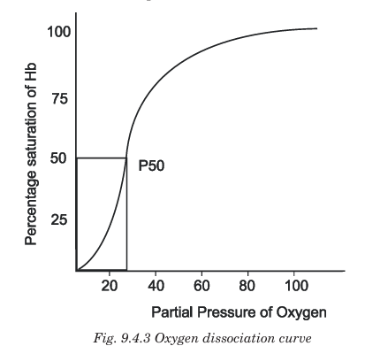
Factors shifting Oxygen–Hemoglobin Dissociation Curve
Right Shift (↓ affinity, ↑ unloading) | Left Shift (↑ affinity, ↓ unloading)
↑ Temperature | ↓ Temperature
↑ PCO₂ | ↓ PCO₂
↑ H⁺ (↓ pH) — Bohr effect | ↑ pH
↑ 2,3-BPG | ↓ 2,3-BPG
Exercise | Fetal Hb

Slide 21
TRANSPORT OF CARBON DIOXIDE
Mode | Percentage
As Bicarbonate (HCO₃⁻) | 70%
As Carbamino compounds (HbCO₂) | 23%
Dissolved in plasma | 7%

Slide 22
BOHR AND HALDANE EFFECT
Concept | Definition | Where useful
Bohr Effect | ↑ CO₂ / ↓ pH → ↑ O₂ unloading | Tissues
Haldane Effect | Oxygenation of blood → ↑ CO₂ release | Lungs

Slide 23
Unit 5

Slide 24
Neural Regulation of Respiration
Breathing is mainly involuntary and is controlled by neural mechanisms to maintain optimal oxygen, carbon dioxide, and pH levels in the body.
Regulation is achieved by:
1️⃣ Respiratory centers in the brainstem
2️⃣ Nerves supplying respiratory muscles
3️⃣ Reflexes from chemoreceptors and mechanoreceptors

Slide 25
RESPIRATORY CENTER IN BRAINSTEM
Location | Center | Function
Medulla oblongata | Dorsal Respiratory Group (DRG) | Inspiration (rhythmic drive, “pacemaker”)
 | Ventral Respiratory Group (VRG) | Forced breathing (active inspiration & expiration)
Pons | Pneumotaxic Center | Inhibits inspiration → ↓ depth & ↑ rate of breathing
 | Apneustic Center | Prolongs inspiration → ↑ depth of breathing

Slide 26
NERVE SUPPLY OF RESPIRATORY MUSCLE
Muscle | Nerve
Diaphragm | Phrenic nerve (C3–C5)
External & internal intercostals | Intercostal nerves (T1–T11)
Accessory muscles | Cranial nerves & spinal nerves

Slide 27
Chemical Regulation of Respiration
Chemical regulation refers to control of respiration by monitoring the chemical composition of blood, mainly pCO₂, pO₂ and H⁺ (pH).
This is done by chemoreceptors, which adjust ventilation to maintain normal gas levels.
Type | Location | Sensitive to | Effect
Central chemoreceptors | Medulla (ventrolateral medullary surface) | ↑ pCO₂ (through ↑ H⁺ in CSF) | ↑ ventilation
Peripheral chemoreceptors | Carotid bodies (major) & Aortic bodies | ↓ pO₂, ↑ pCO₂, ↑ H⁺ | ↑ ventilation

Slide 28
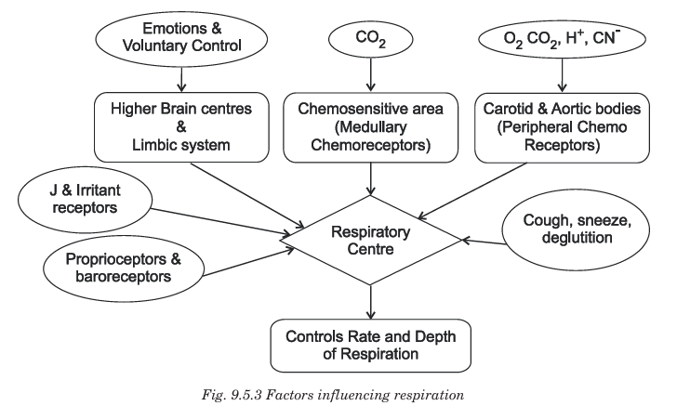

Slide 29
Unit 6

Slide 30
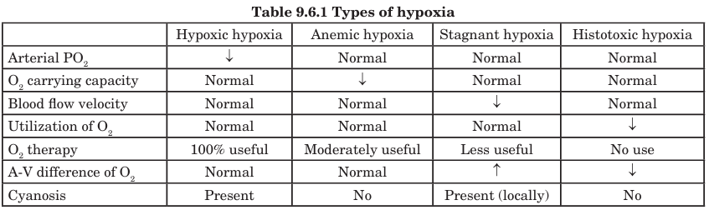

Slide 31
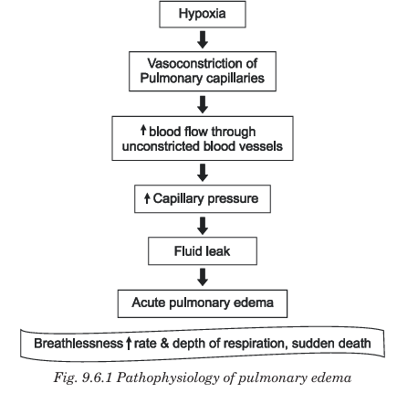

Slide 32
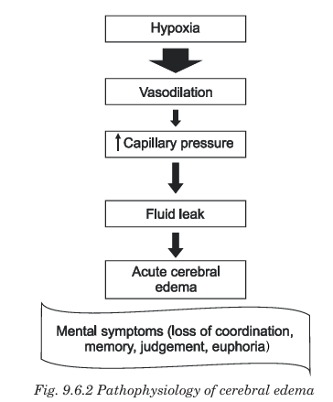

Slide 33
Unit 7

Slide 34
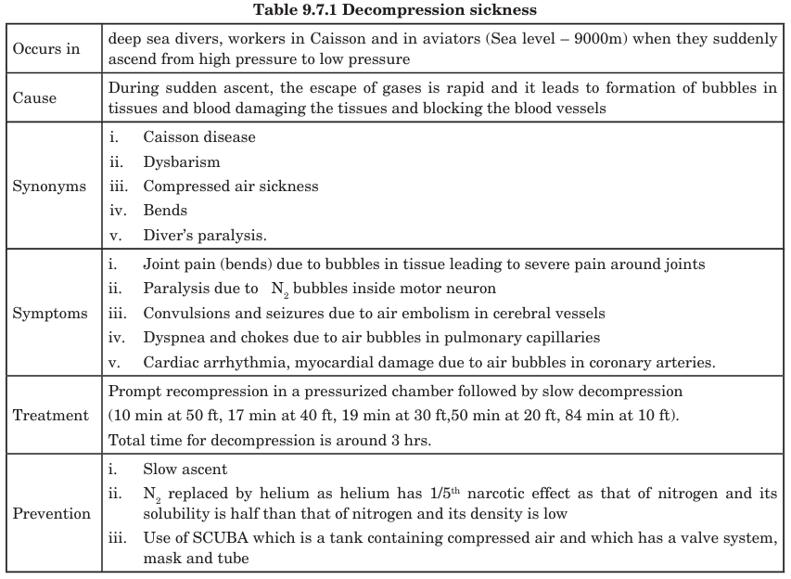

Slide 35
Unit 8

Slide 36
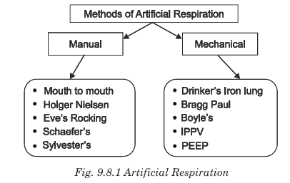

Slide 37
Artificial respiration is indicated in rapid respiratory failure which is caused by the following: Anesthetic accidents, Barbiturate poisoning, Carbon monoxide poisoning, Drowning, Electrocution and Fatal head injury.

Slide 38
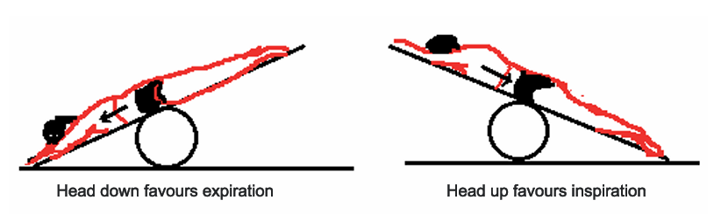

Slide 39
Unit 9

Slide 40
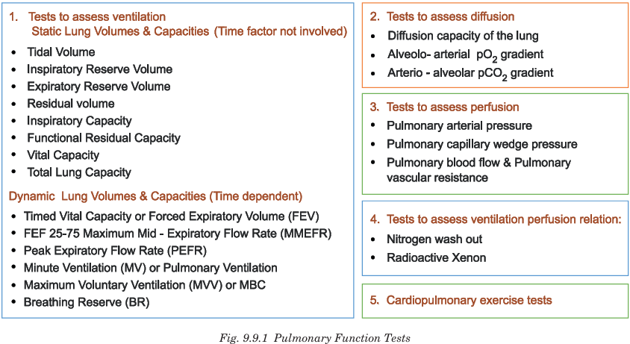

Slide 41
STATIC PFT(PULMONARY FUNCTION TEST)
Parameter | Definition | Normal value
Tidal Volume (TV) | Air inspired/expired during normal breathing | 500 mL
Inspiratory Reserve Volume (IRV) | Extra air inhaled after normal inspiration | 3000 mL
Expiratory Reserve Volume (ERV) | Extra air exhaled after normal expiration | 1100 mL
Residual Volume (RV) | Air remaining after forceful expiration | 1200 mL

Slide 42
CAPACITIES
Capacity | Formula | Normal value
Inspiratory Capacity (IC) | TV + IRV | 3500 mL
Functional Residual Capacity (FRC) | ERV + RV | 2300 mL
Vital Capacity (VC) | IRV + TV + ERV | 4600 mL
Total Lung Capacity (TLC) | VC + RV | 5800 mL

Slide 43
DYNAMIC PFT
Parameter | Meaning | Normal values
FVC (Forced Vital Capacity) | Maximum air exhaled forcefully after deep inspiration | ↓ in restrictive
FEV1 | Air expired forcefully in 1st second | ↓ in obstructive
FEV1/FVC ratio | Proportion of FVC blown out in 1 sec | 80% normal
PEFR | Peak expiratory flow rate | ↓ in asthma
MVV | Maximum voluntary ventilation | ↓ in muscle or airflow problems

Slide 44
APPLIED ANATOMY
Type of lung disease | FVC | FEV1 | FEV1/FVC
Obstructive (COPD, asthma) | ↓ or normal | ↓↓↓ | ↓ (< 70%)
Restrictive (fibrosis, scoliosis, ARDS) | ↓↓↓ | ↓↓ | Normal or ↑

